Slide 1
GCE AS in Applied ICT Unit 2 How organisations use ICT
2. Functions within Organisations
Tom Robinson
Thomas.robinson@filton.ac.uk

Slide 2


Slide 3

Objective
To investigate the different functions within organisations.

Slide 4
Functions within organisations
Within an organisation there will be staff who are responsible for carrying out particular tasks.
These tasks and responsibilities are known as functional areas
Large organisations will have a department for each functional area
Distribution
R & D
Sales
Marketing
Finance
Production
HR
Design
ICT

Slide 5

Accounts or Finance
For the exam this area is split into two parts:
Purchasing
Raise purchase orders
Receive and arrange payment of suppliers' invoices.
Sales Order Processing
Financial dealing with customers.
Organise contracts for services
Receive sales orders
Create and send invoices
Receive and access customers' payments

Slide 6

Sales
Try to persuade people to buy
Organise activities to increase sales
Give demonstrations to potential customers
Provide advice on the best purchases to make
Maintain contact with existing customers
Contact potential new customers.

Slide 7
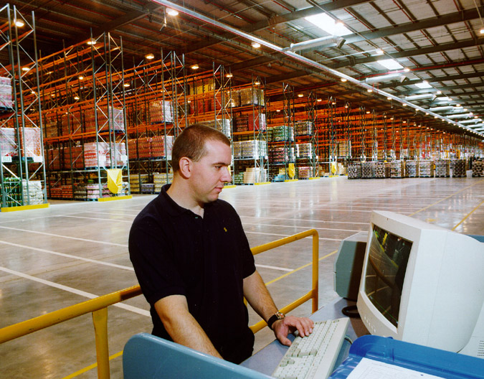
Distribution
Moving goods/stock
Sending goods by mail, road, freight, train or air.

Slide 8

Marketing
Identify customers’ requirements
Market Research
Arrange advertisement campaigns e.g. TV, radio
Arrange promotions e.g. giving out leaflets
Evaluate competition’s products and prices

Slide 9

Research and Development
Most likely to exist in an industrial organisation.
Sometimes used by organisations that provide a service.
Research into new technologies / techniques
Works closely with marketing.

Slide 10
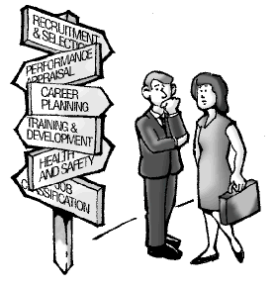
Human Resources
Write job description and advertise vacancies for new staff
Interview applicants for jobs
Arrange staff training
Maintain employee records
Contact details, absence, illness, training
Deal with disciplinary matters
Deal with legal issues
Contracts, health & safety, fair treatment
Handle employee holidays

Slide 11
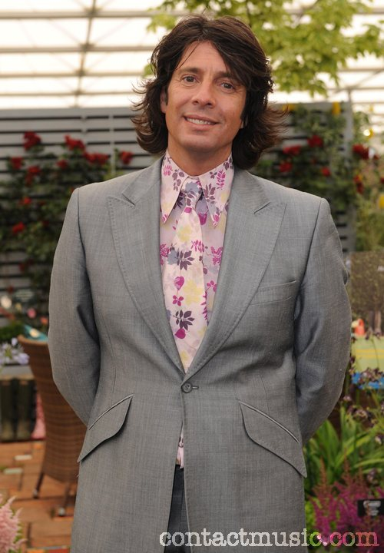
Design
Designing products
e.g. clothes, cars,
Coming up with the ideas / concept
Sketches, computer models, prototypes
Developing ideas generated through R&D.

Slide 12
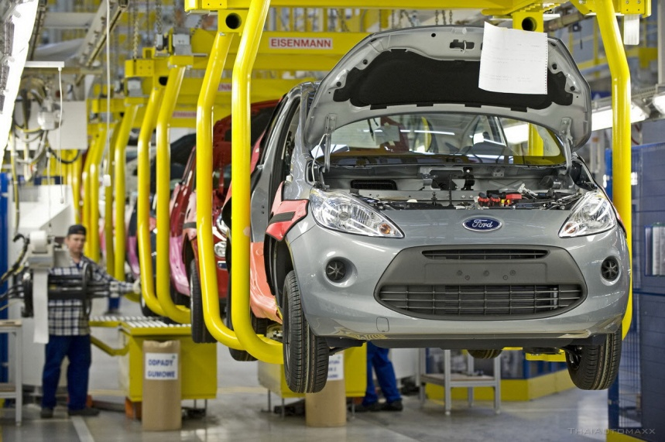
Production (or service provision)
Production of the final product
Testing of the final product
Ensure product meets the original specification
Quality control
Delivery of a service

Slide 13
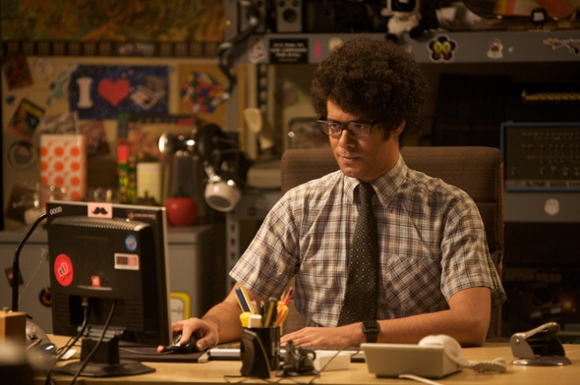
ICT Servicing
Responsible for the provision of all computing facilities within the organisation
Setup, maintenance and security of the network
User support
Company website
Company email system
Small companies may outsource this functional area

Slide 14

Administration
The administration function is usually responsible for the day-to-day running of an organisation.
Looking after the buildings and facilities, general maintenance and cleaning, fleet management and utilities.
Notes:
Administration
The administration function is usually responsible for the day-to-day running of an organisation. This may include things like looking after the buildings and facilities, general maintenance and cleaning, fleet management and utilities. However, administration is often used to describe other functions that do not naturally fit into any of the functions we have considered up to this point. Also, in smaller organisations, other functions such as ICT services or HR may form part of the administration function. This function will need to exchange information with all other functions in varying amounts depending on its precise role within the organisation.

Slide 15
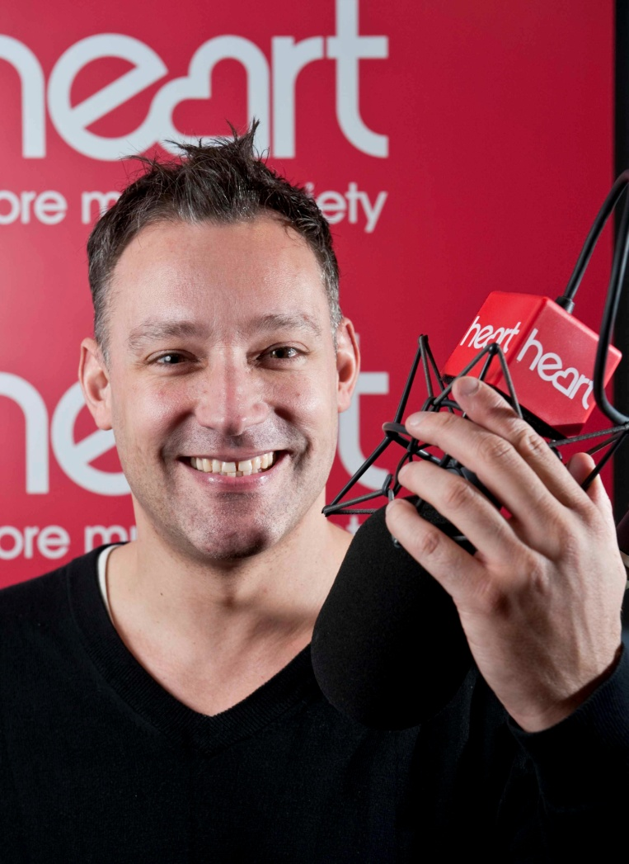
Heart Radio - Bristol
Commercial Radio Station in Bristol (and nationally).
Approximately 30 employees.

Slide 16
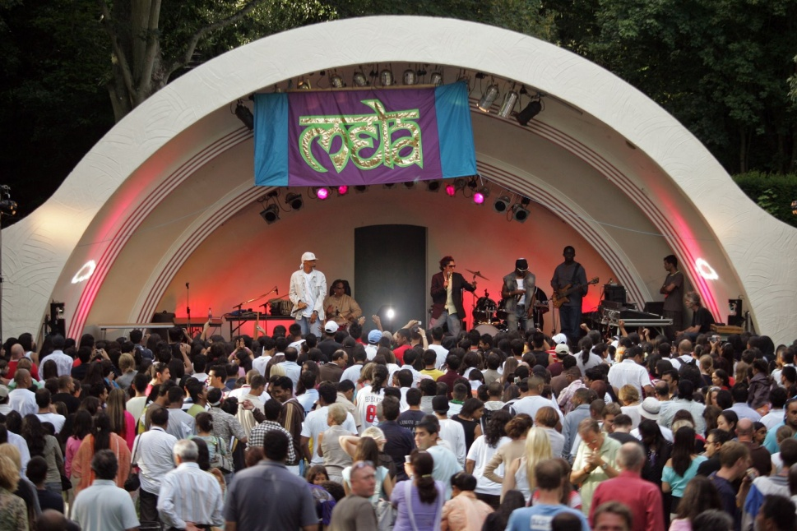
I C Lighting
A stage lighting business based in Swindon, UK.
Sole Trader

Slide 17
Case Study Task
Complete the case study task which is available on FERN.
You now have 30 minutes to complete the task.
If you find you need more time, take the work away with you to finish.
Submission is online through FERN.
Please complete and submit before arriving at the session on Monday 14th March.

